Slide 2
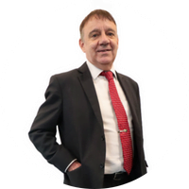
Professor Dr Ian Pashby
Chairman
Group President, Peninsula Higher Education
Professor Ian Robert Pashby graduated from the University of Sheffield (UK) with a bachelor’s degree in Metallurgy and then worked in research and development for Rolls-Royce (aero engines). He joined the Warwick Manufacturing Group at the University of Warwick (UK) as a lecturer, was awarded his PhD for research in the processing of materials and subsequently promoted to Senior Lecturer.
In 2000, he became Professor of Manufacturing Processes at the University of Nottingham (UK).
Professor Pashby moved to the University of Nottingham’s Malaysia Campus in 2007 to become Deputy Head. became Pro-Vice Chancellor and then CEO of the campus in 2008. Returning to the UK in 2013, he became Pro-Vice Chancellor at the University of Hull (UK). He moved back to Malaysia in 2017 to lead the Peninsula Higher Education Group as its Group President.

